Slide 1


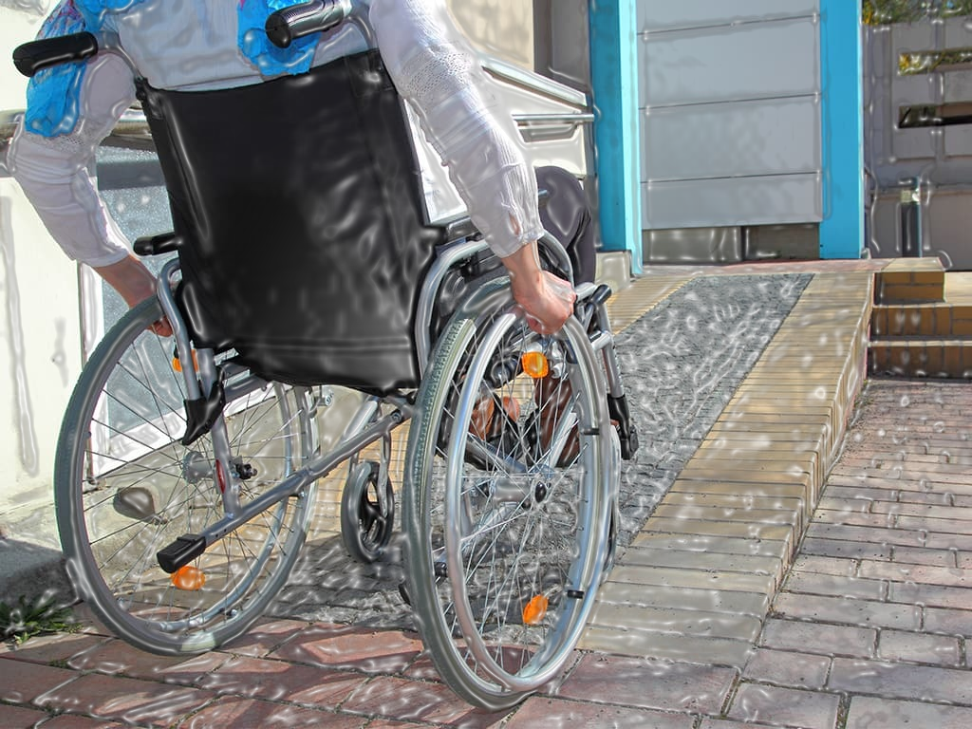
PREDICTING WHEELCHAIR ACCESSIBILITY FOR EVENT CENTERS
By:
Emmanuel Adetunji
Data scientist at National Accessibility

Slide 2

TABLE OF CONTENT
PROBLEM STATEMENT
DATA SET PREPARATION AND PLANNING
DATA ENGINEERING
MODELLING
CONCLUSION

Slide 3

PROBLEM STATEMENT
The company is expanding its business, into installing ramps for event venues.
There is need to accurately predict which event center lack this amenities
To avoid time and resources wastage

Slide 4


PROBLEM STATEMENT CONT.
What our model will do:
Forecasts whether an event center having wheelchair accessibility.
Reduce time and resource spent.
Identify important features

Slide 5
DATA PREPARATION AND PLANNING
Dataset Overview
Summary Statistics
Summary of EDA
Analysis of categorical Variables
Feature relevance
Analysis of Numerical Variables

Slide 6
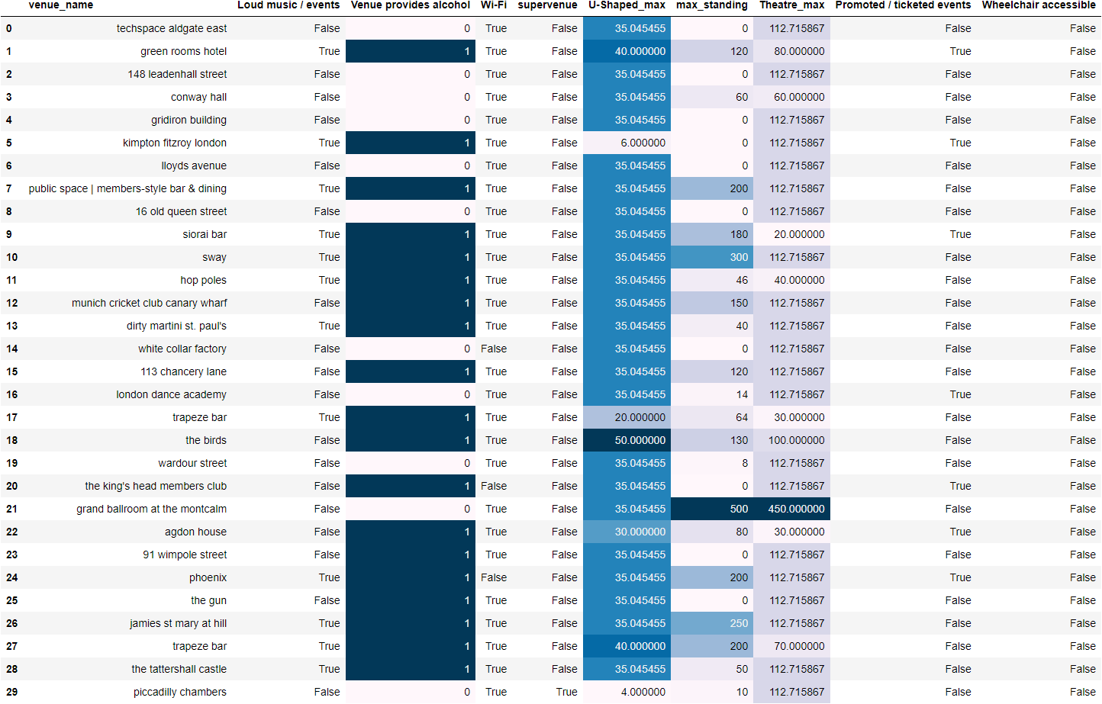
Dataset Overview
All variables do not have NA’s.
Most data entry were duplicated.
We have 1444 unique event venues
Textual column: Venue name.

Slide 7
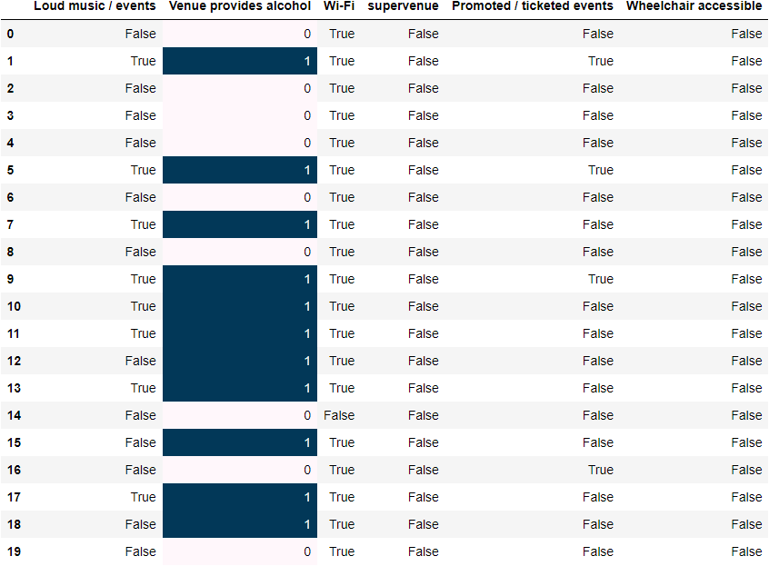

CATEGORICAL FEATURES
6 Categorical features
binary data
nominal data.

Slide 8
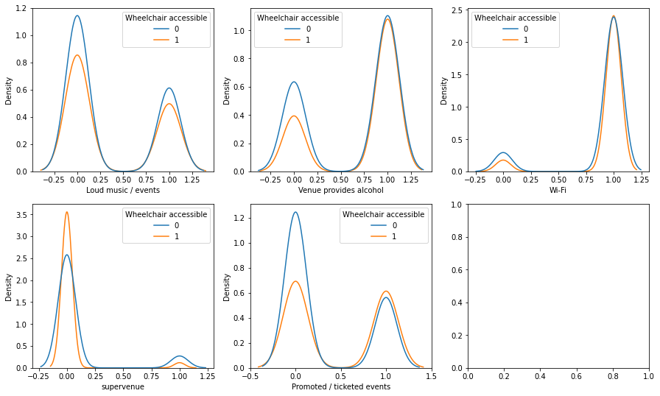
CATEGORICAL FEATURES (DISTRIBUTION)
All categorical features shows skewness.

Slide 9
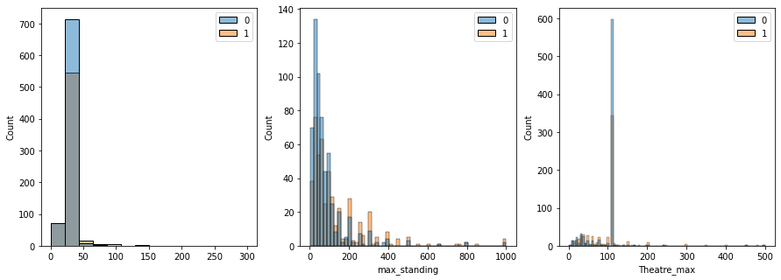
NUMERICAL FEATURES (DISTRIBUTION)
All the variants features of U-Shaped max, max standing and Theatre max show an extreme skewness to the right.

Slide 10
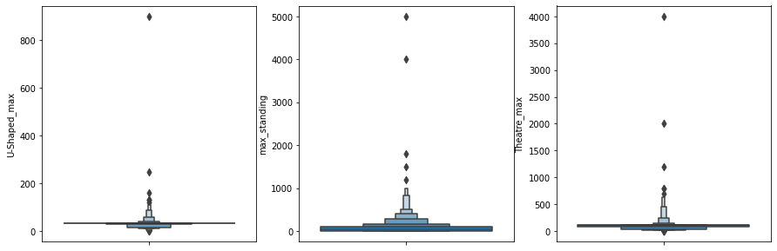
NUMERICAL FEATURES (OUTLIERS)
Box plot diagrams of the features show the availability of outliers in all of the features

Slide 11
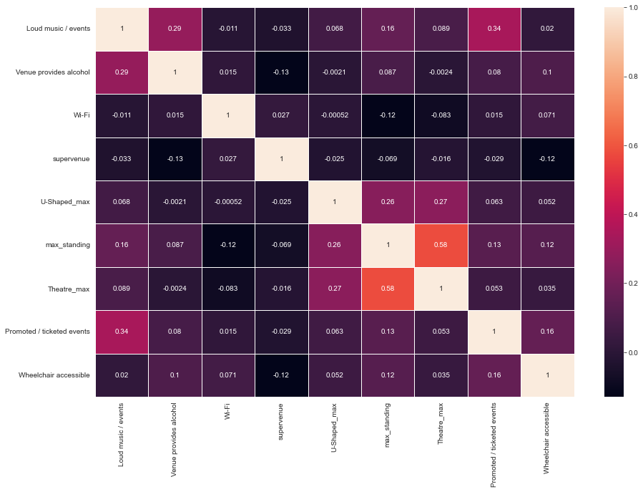
FEATURES (CORRELATION)
The different features are not correlated except for Theatre max and max standing which have a little relationship with each other

Slide 12
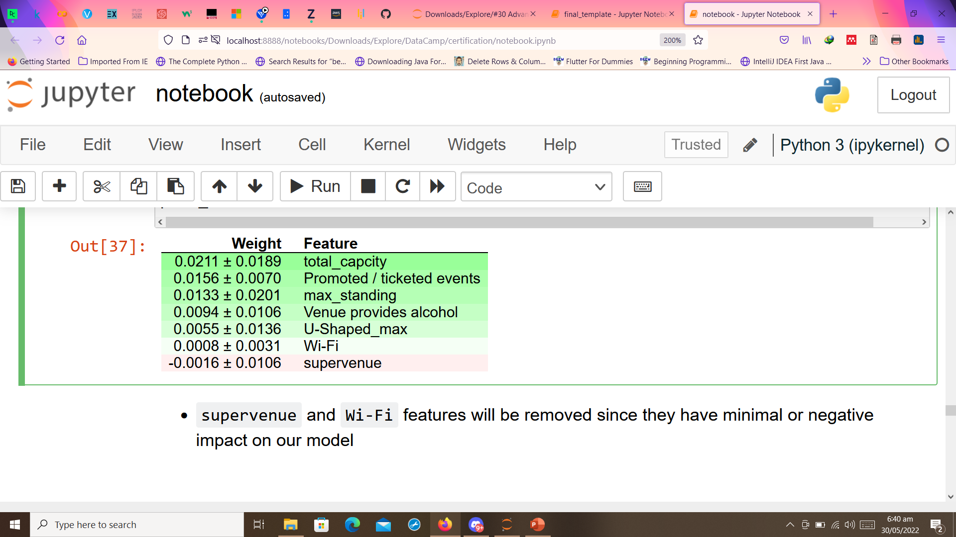
DATA ENGINEERING
Outliers were dealt with
Using feature importance (RandomForest) will removed features which are not good for our models

Slide 13
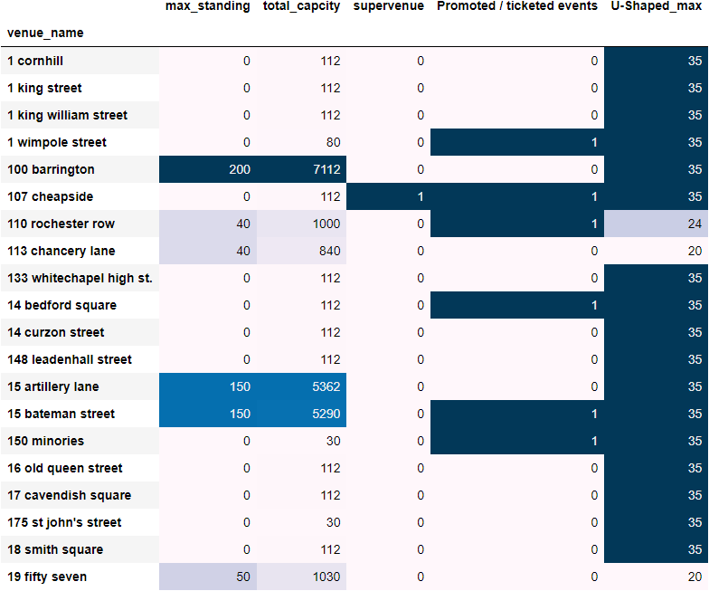
DATA ENGINEERING CONT.
Elimination of some features using Pearsonr method.
New feature engineered to give more information.

Slide 14
Data shared: Training Validation/Test
Task | Classification
Training set: | 1023 rows, 5 predictors, 1 target response
Validation/Test | 256 rows, 5 predictors, 1 target response
Predictors: | Promoted / ticketed events, super-venue, max standing, total capacity, U-Shaped max
Response: | Wheelchair accessible

Slide 15
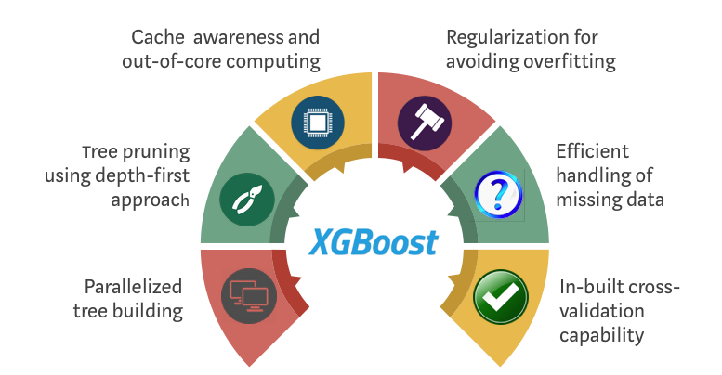
MODELING: XGBOOST
XGBoost: Stands for Extreme Gradient Boosting, is a scalable, distributed gradient-boosted decision tree (GBDT) machine learning library

Slide 16
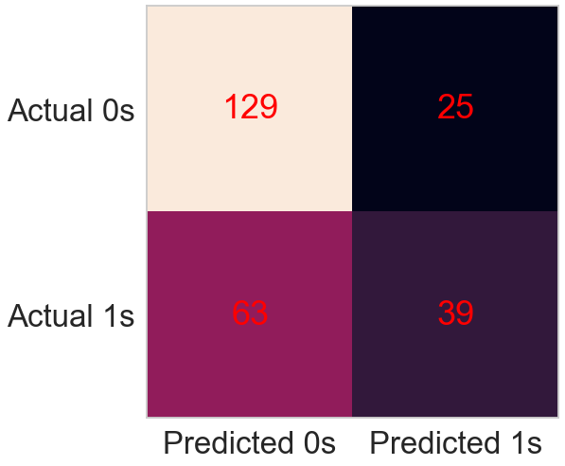
CONFUSION MATRIX FOR MODEL PERFORMANCE
129 true negative predictions
63 false negative predictions
25 false positive prediction
39 true positive predictions

Slide 17
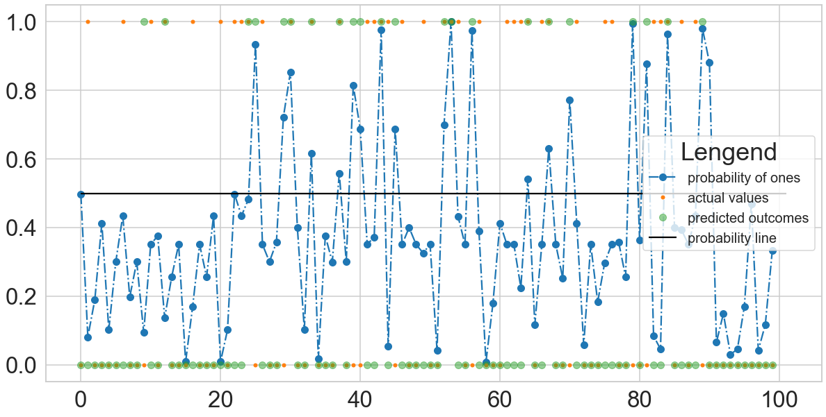
MODEL PERFORMANCE CONT
Visual showing how the first 100 values of our validation dataset performs

Slide 18
STRATEGY RAP-UP
What we have already employed
Engineer new features
Categorical datatypes converted into numeric data-type
New features: Total capacity
Narrow down our dataset features
Variable Selection
Statistical relevance
Feature importance of predictors on machine learning model(s)
Models use for training
Logistic Regression Classifier
Random Forest/ Trees Classifier
XGBoosting
Bagging Ensemble

Slide 19

STRATEGY RAP-UP CONT’D.
What we look forward to use
Engineering more features
Model tuning
Variable transformation
Most importantly, Your Suggestions

Slide 20

CONCLUSION
Our solution will;
effectively and fairly predict an event center having a wheelchair ramp.
reduce time spent in reaching out to individual event center.
minimize resource spent.
give insight into features most useful for prediction.

Slide 21

THANK YOU

